Slide 1
RATING
Buy
INITIATING COVERAGE · BUY
Acme Semis
PRICE TARGET
$58
ACME · NASDAQ · USD · spot $44
+32% vs spot
Services mix doubles by FY27, lifting blended GM 820 bps and re-rating PE from 22x to 27x. Four dense IC dashboard layouts showcased: 2+1 (A/B) and 2+2 (a/b).
FY27E EPS
$3.42
Consensus $3.12 (n=18)
TIMEFRAME
12 mo
Uninodue · Investment Research

Slide 2
REVENUE & MARGIN BUILD
02
Services mix doubles by FY27, lifting blended GM 820 bps.
Hardware base + Services growth → blended margin re-rate
Revenue by segment ($B, FY)
KEY TAKEAWAYS
Mix shift drives lift
Services revenue share 22% → 40% by FY27 underpins +820 bps blended GM expansion.
Margin compounds
Blended GM 44.7% → 52.9% — Hardware holds, Services adds 540 bps at the segment level.
Gross margin build (%)
Segment
FY25
FY27E
Δ bps
Hardware
38.2%
39.1%
+90
Multiple re-rate
Services
62.4%
67.8%
+540
Fwd PE 22x → 27x as Services becomes >40% of revenue; comps trade 25–32x.
Blended
44.7%
52.9%
+820
Source: ACME 2026-04-29 IC Memo, Internal forecast. Est. denotes our forecast.
Uninodue · Investment Research
Uninodue · Initiating Coverage · 2026

Slide 3
Q3 SCORECARD — 2+1 (A)
03
Beat across the board; Services drove 65% of upside.
Top-line + margin + cash flow snapshot vs sell-side consensus
REVENUE BEAT
GROSS MARGIN
KEY TAKEAWAYS
+4.1%
+820 bps
$5.1B vs cons $4.9B; Services drove 65% of the upside.
Services GM 67% pulls Hardware 38% higher as mix doubles.
Beat across the board
Revenue +4.1% and EPS +9.0% vs consensus — Services-led upside with hardware merely in-line.
Revenue ($B, Q3)
Blended GM (%, FY)
GM beat is structural
+220 bps lift driven by mix not pricing — sustainable into FY26 as Services share continues to scale.
Gross margin build (%)
Segment
FY25
FY27E
Δ bps
Driver
Hardware
38.2%
39.1%
+90
Unit cost down + premiumization
Services
62.4%
67.8%
+540
Take-rate +24% as enterprise tier scales
Hardware ASP softer
Watch Q4 ASP for share-cycling — consensus models flat hardware GM through FY26 which may prove optimistic.
Blended
44.7%
52.9%
+820
Services share 22% → 40% of revenue
Source: ACME 2026-04-29 Q3 FY26 Filing, Bloomberg consensus n=18. Est. denotes our forecast.
Uninodue · Investment Research
Uninodue · Initiating Coverage · 2026

Slide 4
Q3 SCORECARD — 2+1 (B)
04
Beat across the board; Services drove 65% of upside.
Top-line + margin + cash flow snapshot vs sell-side consensus
REVENUE BEAT
GROSS MARGIN
KEY TAKEAWAYS
+4.1%
+820 bps
$5.1B vs cons $4.9B; Services drove 65% of the upside.
Services GM 67% pulls Hardware 38% higher as mix doubles.
Beat across the board
Revenue +4.1% and EPS +9.0% vs consensus — Services-led upside with hardware merely in-line.
Revenue ($B, Q3)
Blended GM (%, FY)
GM beat is structural
+220 bps lift driven by mix not pricing — sustainable into FY26 as Services share continues to scale.
EPS BEAT
OP MARGIN
FCF
NET CASH
+9.0%
23.1%
$0.9B
$2.1B
$0.85 VS CONS $0.78
+180 bps YoY
+18% YoY
+$0.3B Q3 BUILD
Hardware ASP softer
Operating leverage from mix shift plus modest buyback drove the bottom-line beat.
Mix shift dropped to operating line; opex grew slower than revenue.
Working capital release plus tighter capex pacing as Fab-12 phase 1 wraps.
~17% of market cap; supports buyback acceleration into 2H26.
Watch Q4 ASP for share-cycling — consensus models flat hardware GM through FY26 which may prove optimistic.
Source: ACME 2026-04-29 Q3 FY26 Filing, Bloomberg consensus n=18. Est. denotes our forecast.
Uninodue · Investment Research
Uninodue · Initiating Coverage · 2026

Slide 5
Q3 SCORECARD — 2+2 (a)
05
Four operating signals; all align with the FY27 mix-shift thesis.
2×2 parallel cards — each a minimum unit (chart + hero + text)
REVENUE
BLENDED GM
KEY TAKEAWAYS
$31.2B
52.9%
FY27E rev, **+22% CAGR** FY23-27.
FY27E, **+820 bps** vs FY25 from Services mix.
Beat is broad-based
Revenue +4.1%, EPS +9.0%, OP margin +180 bps, FCF +18% — all 4 KPIs above consensus.
Revenue ($B, FY)
Blended GM (%, FY)
GM lift is structural
+220 bps Q3 lift extends the FY25 → FY27E +820 bps trajectory; mix not pricing.
EPS
FCF
$3.42
$3.6B
FY27E, **2.0× FY24** on margin + buyback.
FY27E, capex pacing tightens post Fab-12.
Cash flow inflects
$0.9B Q3 FCF supports accelerated buyback into 2H26; net cash $2.1B = 17% of mkt cap.
EPS ($, FY)
FCF ($B, FY)
Source: ACME 2026-04-29 Q3 FY26 Filing, Bloomberg consensus n=18. Est. denotes our forecast.
Uninodue · Investment Research
Uninodue · Initiating Coverage · 2026

Slide 6
SEGMENT DEEP-DIVE — 2+2 (b)
06
Services growth drives mix shift; Hardware holds margin floor.
Each row: chart on left, freely composed content on right
Revenue mix ($B, FY27E)
SERVICE REVENUE SHARE, FY27E
KEY TAKEAWAYS
42%
Mix shift = margin lift
Services 22% → 40% of revenue; blended GM 44.7% → 52.9% by FY27E.
106.9
Services reaches **$13B** of FY27E revenue, **42%** of the mix vs **22%** in FY24. The transition lifts blended GM **820 bps** as Services 67% pulls Hardware 38% higher.
Hardware holds the floor
Hardware GM +90 bps through FY27 from premiumization, not exposed to ASP cycle.
Segment GM build (%)
Gross margin build (%)
Segment
FY25
FY27E
Δ bps
Hardware
38.2%
39.1%
+90
Underwrites re-rate
Services
62.4%
67.8%
+540
+820 bps GM lift + 40% Services share supports PE re-rate from 22x to 27x by FY27.
Blended
44.7%
52.9%
+820
Source: ACME 2026-04-29 IC Memo, Internal forecast. Est. denotes our forecast.
Uninodue · Investment Research
Uninodue · Initiating Coverage · 2026

Slide 7
CATALYST + WATCH ITEMS
08
Six events through 4Q26 across catalysts, watch items, and peer cycles.
3-pillar derived: text on top, chart at bottom of each pillar
NEAR-TERM CATALYSTS
WATCH RISKS
PEER CYCLE
3 events lift FY27 EPS +$0.30
2 events with downside skew
1 event tied to industry tape
Services APAC launch (Q2): **+$0.15** EPS if first-month ARPU clears $12. Fab-12 ramp (Q3): **+180 bps** GM from 85% utilization. FY27 guide (Q1 27): re-rate trigger if Services growth guide clears 18%.
EU DMA ruling (Q4): downside scenario **-5 to -8%** if restrictive remedies land. Lock-up expiry (Q2 27): 12-month supply overhang from pre-IPO insiders.
TSMC capex guide (Feb 27 earnings): supply-cycle read-through for Hardware ASP into FY27 — watch capex/sales above **35%** as tell for tight supply.
EPS uplift by event ($)
Downside scenarios (%)
TSMC capex/sales (%)
Source: ACME 2026-04-29 Catalyst tracker, Internal. Est. denotes our forecast.
Uninodue · Investment Research
Uninodue · Initiating Coverage · 2026

Slide 8
SEGMENT TRAJECTORY
09
Hardware holds, Services scales, Blended re-rates by FY27.
3-pillar derived: text on top, table at bottom of each pillar
HARDWARE
SERVICES
BLENDED
Floor margin holds
Mix-shift engine
Re-rate underwrites PT
GM **38.2% → 39.1%** through FY27 from premiumization, not exposed to ASP cycle. Volume mix shifts into higher-tier SKUs as APAC enterprise tier scales.
Revenue **$5.8B → $13.0B** through FY27, GM lifts **+540 bps** as APAC enterprise tier reaches 40% of mix. Take-rate up 24%.
**+820 bps** blended GM lift drives PE re-rate from **22x → 27x** as Services becomes >40% of revenue. Comps trade 25-32x.
Hardware build (%)
Services build (%)
Blended (%)
FY25
FY27E
FY25
FY27E
FY25
FY27E
Rev ($B)
14.1
18.2
Rev ($B)
5.8
13.0
Rev ($B)
19.9
31.2
GM
38.2%
39.1%
GM
62.4%
67.8%
GM
44.7%
52.9%
ASP ($)
142
156
Take-rate
18%
22%
PE (x)
22
27
Source: ACME 2026-04-29 IC Memo, Internal forecast. Est. denotes our forecast.
Uninodue · Investment Research
Uninodue · Initiating Coverage · 2026

Slide 9
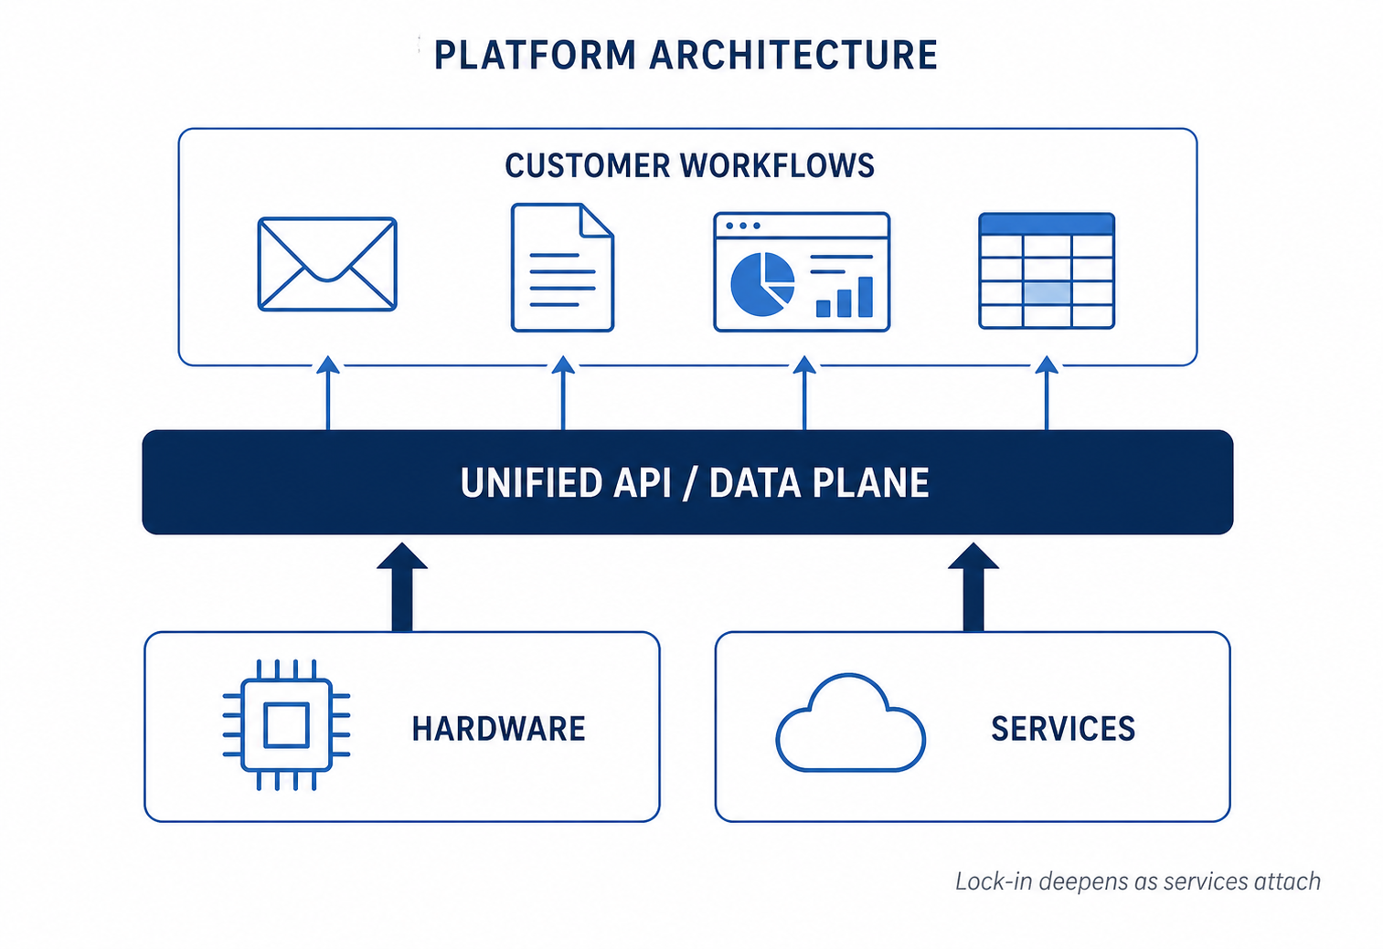
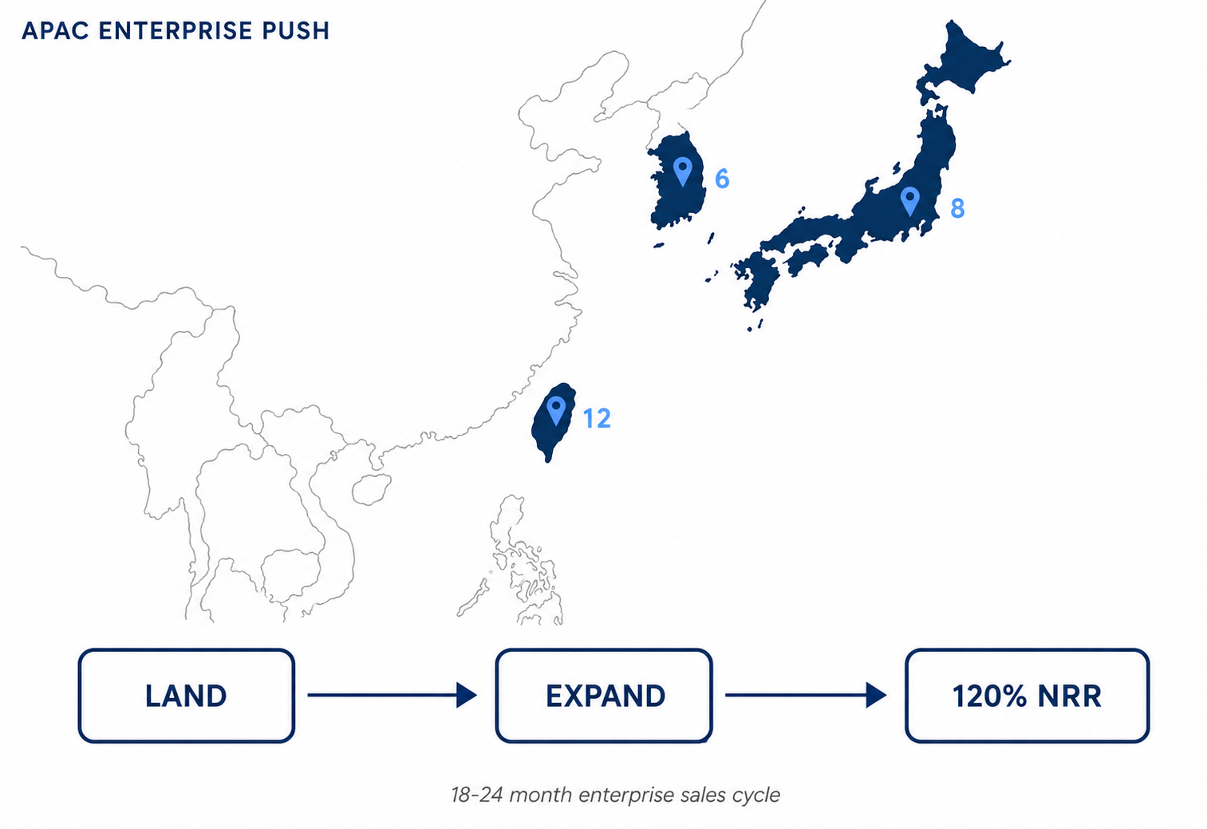
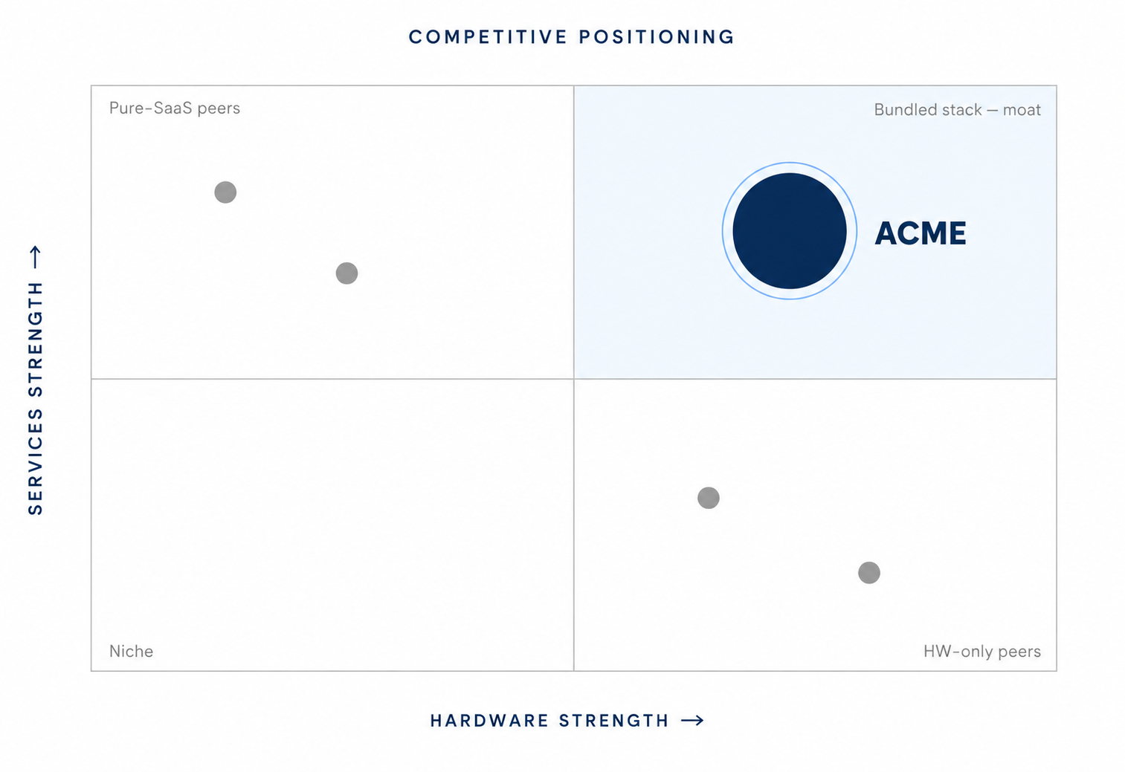
PRODUCT & STRATEGY
10
Three product pillars underwrite the FY27 Services thesis.
3-pillar derived: text on top, image placeholder at bottom of each pillar
PLATFORM
GO-TO-MARKET
COMPETITIVE
Unified data fabric
APAC enterprise push
Moat = bundled stack
Single API across Hardware + Services lets enterprise customers consolidate workloads. **Lock-in deepens** as services revenue grows; switching cost rises with usage.
Direct sales-led model in TW/JP/SK targeting fortune-500 anchor accounts. **18-24 month** sales cycle but high net retention (~120%) once landed.
Peers compete on Hardware OR Services; ACME bundles both with shared data plane. **Switching cost** rises with services attach as customers integrate workflows.
Platform architecture (illustrative)
APAC GTM motion (illustrative)
Competitive positioning (illustrative)
Source: ACME 2026-04-29 IC Memo, Internal. Est. denotes our forecast.
Uninodue · Investment Research
Uninodue · Initiating Coverage · 2026

